Slide 1

CLASS OF 2028
PARENT PEER GROUP MEETING
SPRING 2026

Slide 2
Class of 2028 Parent Peer Group Meeting Agenda
  Financial Report
  Social Team Update
  Merchandise Update
  Spirit Night Update
  Guest Speaker - Maurine Richter
  Sophomore Class Updates and Q&A - Ms. Prontka & Ms. Blackmon

Slide 3
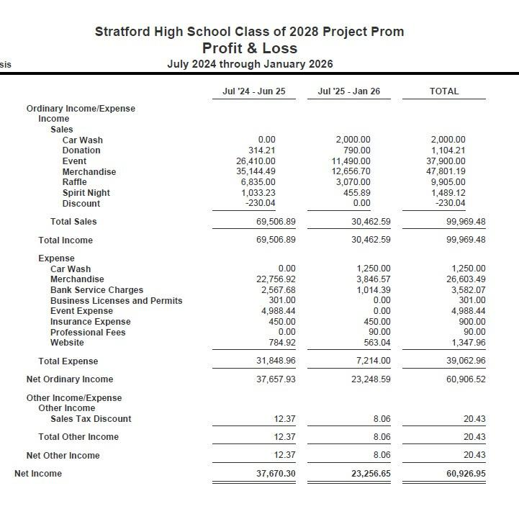
Class of 2028 Project Prom Profit & Loss
July 2024 thru Jan 2026

Slide 4

CLASS OF 2028 SOCIAL UPDATE
  Mahjong event in January was well attended and fun
  Our 50/50 Raffle is up to over $4000 - purchase raffle tickets thru 2/28!

Slide 5
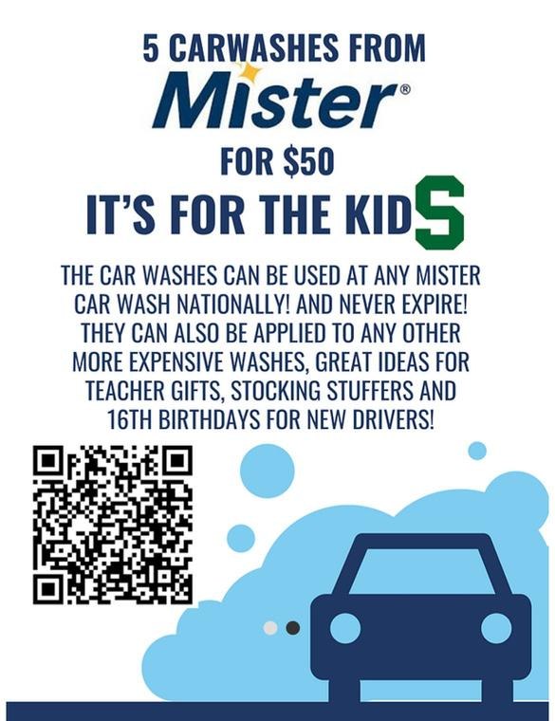
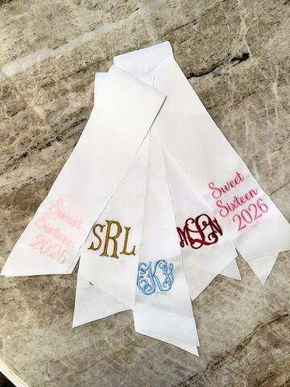



CLASS OF 2028 MERCHANDISE UPDATE
Dog T-Shirts, Dri-fit Hooded T-Shirts,
Sweet 16 Ribbons, Umbrellas, Block ‘S’ T-shirts,
Car Wash Bundles and Minted Discount
ALL AVAILABLE!

Slide 6
CLASS OF 2028 SPIRIT NIGHT UPDATE
  Thanks to all who participated in Fajita Flats and Carrabba’s Spirit Nights
  Our next Spirit Night will be at Becks Prime, details to be communicated soon!

Slide 7

High School to College Transitions
Tenth Grade Parent Peer Meeting
Presented by
Maurine Richter

Slide 8

P.
MAURINE
“MOE”
RICHTER

Slide 9

The Journey Begins now!
I know. I know.
Parents think they have plenty of time, but actually, your children have already begun their college application journey.

Slide 10

Academics
Transcripts for college applications begin with the very first report card of freshman year, which actually accounts for more of the GPA than the grades from their senior year.

Slide 11

The courses your students take do matter…
Advanced courses can help GPA’s as they merit increased grade points. But, only have your student take advanced courses where they can succeed. An A in a grade level class is equal to a B in an advanced course, and it is definitely better than a C made with lots of stress in a course too difficult for their skill set.
Is your student good at Math? Language Arts? Science or Social Studies? If so, choose their strengths when selecting advanced courses.
And don’t forget….
Your student needs to do their best in all courses, not just the ones where they like the material and/or the teacher.

Slide 12
Grade Level? PAP? Advanced Placement? Dual Credit? Early College Program?
Grade Level Courses are prepared for the typical student. An A is worth 6 points.
PAP, or Pre-Advanced Placement, can begin in middle school for both math and foreign language and count towards high school credit, but do not impact your GPA. An A is worth 7 points. PAP Designations continue in 9th-10th grades.
AP, Advanced Placement courses, begin as early as sophomore year. These courses are more rigorous and challenge students to push themselves in preparation for college. These courses count for high school credit, but can also result in college credits following AP Exams. You must score at least a 3 for college credit, although some universities only accept 4s and 5s. An A is worth 7 points.
Dual Credit courses give you high school and college credits at the same time. There is not an exam at the end. An A is worth 7 points. These are accepted at Texas colleges and some out-of-state schools as well.
ECP, or Early College Program, includes UT OnRamps and HCC ECP. These are actual college level courses that also give you high school and college credit. An A is worth 7 points.

Slide 13

GPA, Class Rank, and All That Jazz
Students are ranked into quarters by their grade point average. Your goal is to finish in the top two quarters. You will have a choice on whether to place your rank on your transcript.
There are multiple valedictorians and salutatorians based on their GPA, rather than their real averages. A 90 receives the same grade points as a 99.
You are allowed four advanced courses per year. The top GPA at Stratford is a 6.5 weighted on a 6.0 weighted standard.
State schools in Texas have a rule that top 10% are automatically admitted with the exception of UT Austin who auto admits only the top 5%.

Slide 14

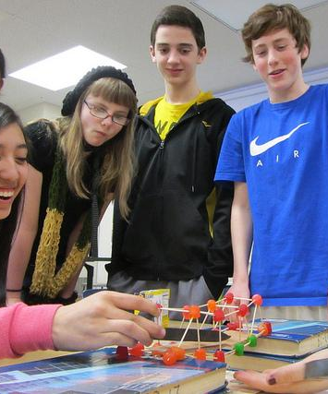

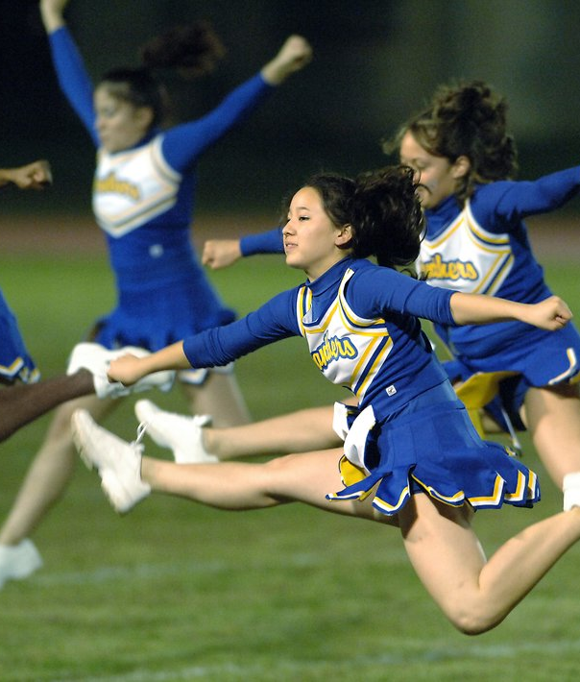
Extra-Curricular
Activities show that you are well-rounded!
Colleges want diverse students, so be unique.
Select one to three extra-curricular activities.
Stick to these activities to show you are committed.

Slide 15
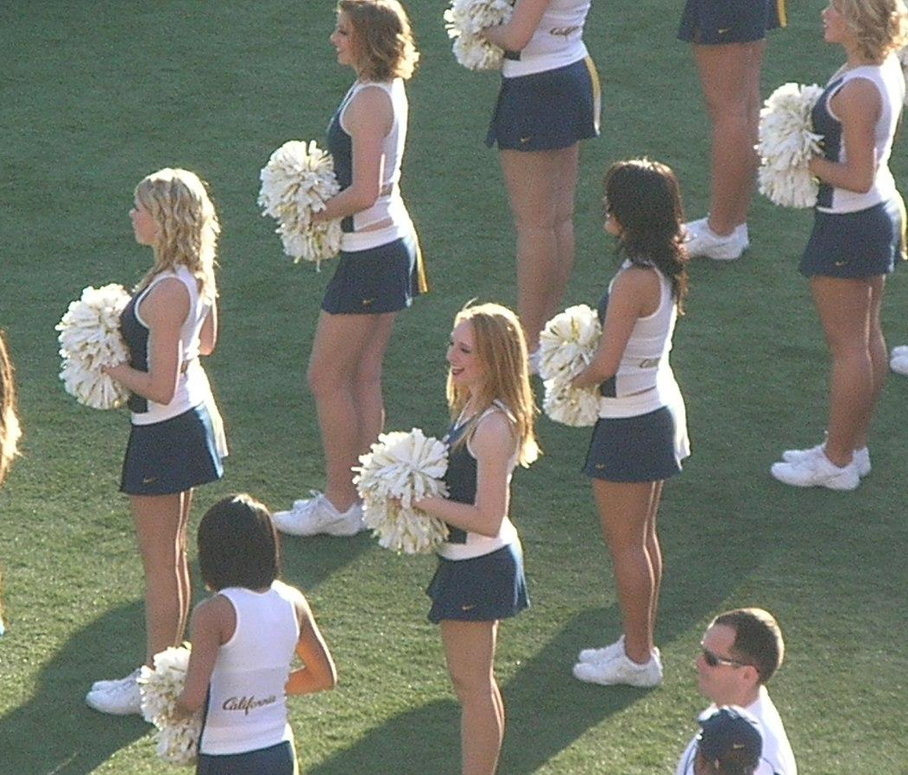
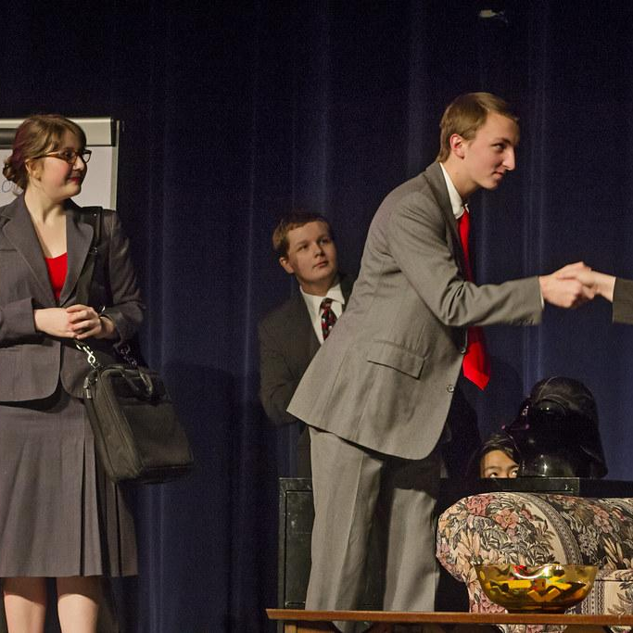
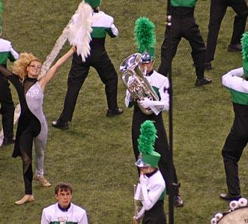
Great
Extra-Curricular Activities
Encourage your student to share their talents in …
Band
Theater
Choir
Orchestra
Debate
Art
Journalism
Computer Science and Coding

Slide 16



Athletics
Playing on a team can have a positive effect on your future. Get or stay involved in a healthy activity and learn how to be competitive, work with others, and commit to excellence.
FOOTBALL BASEBALL
SPARTANAIRES BASKETBALL
CHEER VOLLEYBALL
BOWLING CLUB SPORTS
SOFTBALL GOLF
LACROSSE TRACK
BALLET AND DANCE

Slide 17



Academies and Internships
CAREER AND TECHNOLOGY COURSES LOOK GREAT TO COLLEGES AND OFTEN LEAD TO INTERNSHIPS, SCHOLARSHIPS, AND AN IDEA ABOUT YOUR FUTURE CAREER.
CHECK OUT THE GUTHRIE ACADEMY OF REAL ESTATE, ACADEMY OF BUSINESS, AND HOSA - HEALTH OCCUPATION STUDENTS OF AMERICA.

Slide 18


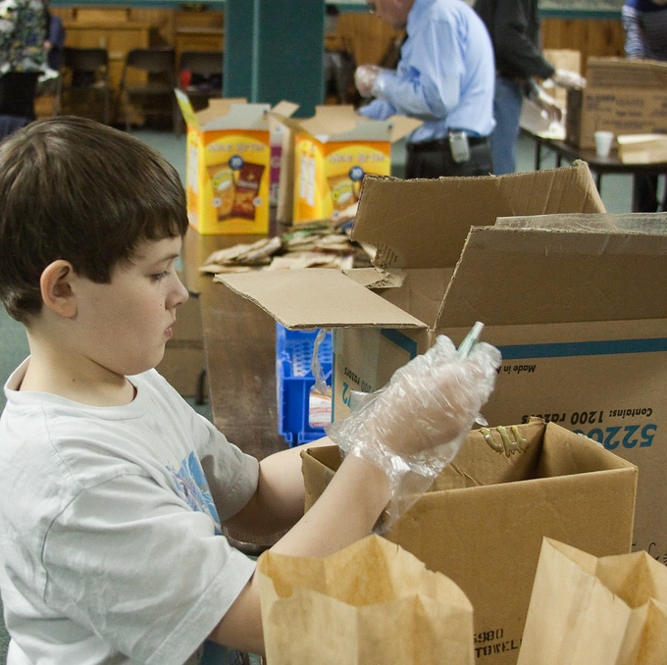
Community Service
Colleges look for prospective students who are actively engaged in helping others. Rather than lots of little service, choose three to five BIG commitments.
Family Point Resources
Local Church projects
Boys and Girls Country
Church Mission Trips
BIG Day
Gracewood Casseroles
MAMs
CAPs

Slide 19

Employment, Internships and Summer Activities
Babysitting
After School Nanny
Retail
Yard Work
Transportation
Summer Camp Counselor
Food Service
Internship

Slide 20

SOME EXTRAS
TO CONSIDER
YOUNG LIFE
STUDENT COUNCIL
NATIONAL HONOR SOCIETY – NO ISS, SUSPENSIONS, AND MINIMUM GPA OF 6.0
OFFICE ASSISTANT
SCHOOL CLUBS
SPIRIT CLUBS AND TRI-THETA
MENTORSHIPS

Slide 21

Sophomore Year
Start preparing for and taking any tests to fulfill high school graduation requirements. Prepare for PSAT and SAT by downloading SAT Word of the Day, practicing on Khan Academy, and reading the newspaper weekly.
Polish up study skills. Reinforce the idea that colleges and future employers look at high school transcripts and are impressed with regular attendance and improving grades.
Have your child take a career inventory test and discuss interests and long term goals.
Sophomore year is the perfect time to begin researching and visiting colleges. Begin with your alma mater, visits to our local universities, and in-state colleges.
Select five to ten colleges to contact for brochures and applications.
Sign up for the most challenging classes for next year. Know the differences between Pre-AP, AP, Dual Credit and ECP (Early College Program).
Choose AP courses in strongest areas. Taking an AP class requires commitment and responsibility. If one AP class is all your teen can handle, then do not overload them with two, three or four. An A in a grade level class carries the same grade points as a B in an AP class.
Get to know NAVIANCE!!!! Use this excellent site to track your college interests.
Plan a productive summer. The summer before 11th grade is a good time to have a part-time job to prepare for a future career.

Slide 22

Junior Year-
Get Ready…
Keep track of high school credits and graduation requirements
Sports in college? You must start this process as soon as possible!
Compare personal calendar with the SAT and ACT calendar – plan and register online for your SAT & ACT exams this fall even if you are taking them in the spring!
Did you know that you can link your PSAT scores to Kahn Academy and access free, personalized SAT prep? Go to www.collegeboard.com to find this resource
Organize your college files. Make sure you keep copies of all things related to your time at SHS.
Build a positive rapport with your junior-year teachers!
Letters of recommendation are written in the summer following your junior year by teachers you had in grades 9-11. Some colleges/universities DO NOT require a letter. Call the admissions office at the college/university that you would like to attend.

Slide 23

Junior Year is an opportunity to keep getting stronger.
If you haven't already, familiarize yourself with Naviance and Skyward. You'll complete many counselor assigned tasks here over the next two years such as updating resumes, performing college match searches, finding scholarships and requesting recommendation letters.
Juniors take the PSAT in October and the SAT and ACT tests in the fall and spring. Retakes continue in the summer.
Attend city-wide college meetings which are usually held at local hotels or schools in the evening or on weekends.
Use college websites for “virtual tours” when you can’t visit a campus.
If you have a social security number, memorize it now. You will use it to register for tests and on college applications.
Interested in one of the military academies? There are local representatives who will assist you with the process. You must begin this process in your junior year. See your counselor or post-secondary counselor for information.
If you are serious about attending college out of state and your family has the resources, begin visiting colleges on long weekends, spring break, and next summer. Look for Saturday events! Don’t wait until senior year!

Slide 24
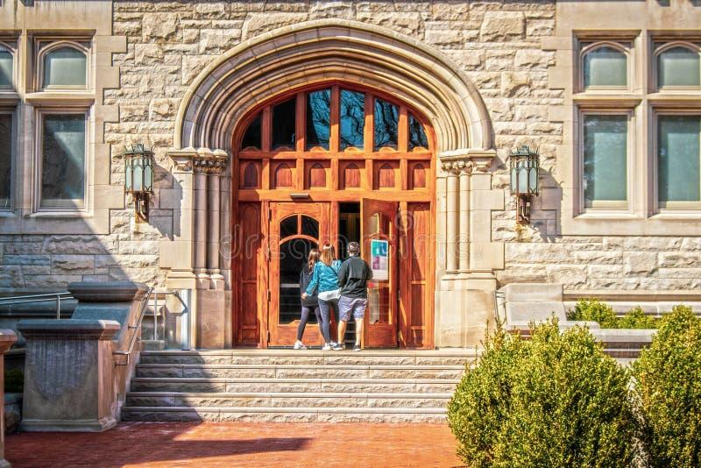
Beyond The University of Texas and Texas A&M
  Please understand that while these are our premier state universities, they cannot accept ALL students and have become more selective each year.
  Introduce your student to great schools both in and out of the state of Texas. Highlight beautiful cities, great opportunities, and visit a variety of colleges from small towns to large cities, from East to West, and from North to South.
  Help students to understand that there are always open doors when an expected door closes.

Slide 25

Wrap Up
What to Look For in Junior Year
  Expanded Resumes
  Brag Sheets
  Teacher Recommendations
  College Essay – Personal Statement
  Short Essays by College
  Common Application or
  Apply Texas

Slide 26


Sophomore Year- Spring Edition
Class of
2028
Stratford High School

Slide 27
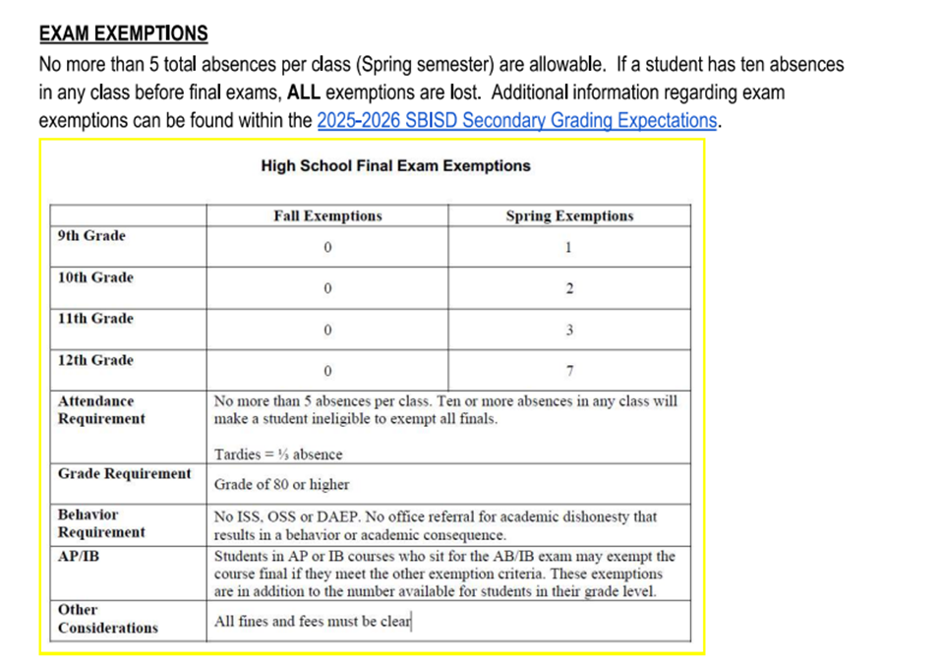

Slide 28
Any absence counts towards attendance.
Excused (out all day with a note from a doctor)
Excused (out for a specific reason / approved by administration)
Not excused but sick
Excused absences mean students can make up work
Present but out for school or other
School extra-curricular events (sports, fine arts)
Testing but not in class
Any student can come see Ms. Prontka and go over their attendance

Slide 29
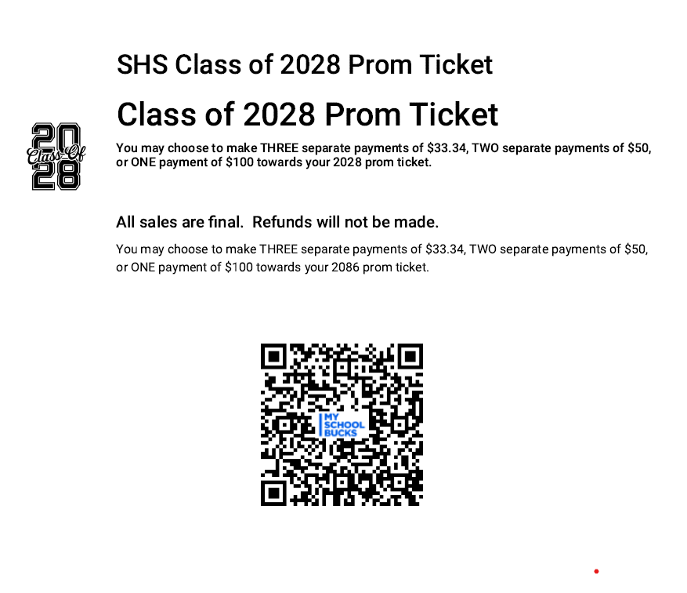

Slide 30


Get Involved!
Clubs
Sports
Outside
Keep a running record!

Slide 31


Course
Selection
Spring semester
Several Opportunities to make changes
Deadline for changes May 29th

Slide 32
Advanced Options
Advanced Academic Course (AAC)- HS Credit only
Dual Credit (DC)- HS & College Credit through HCC
Dual Enrollment (DE)- HS & Potential College Credit through University of Texas
Advanced Placement (AP)- HS & Potential College Credit based on exam results
All apply to the GPA Boost!

